Slide 1
Electrical signals of nerve cells
By: Nicole Phillips

Slide 2
Learning Objectives
Describe the makeup of the cellular membrane
Identify important ions and their role in neural communication
List and sequence the steps of generating an action potential including the movement of ions across the cell membrane and the forces that drive their movement

Slide 3
Part 1:
The resting membrane potential

Slide 4
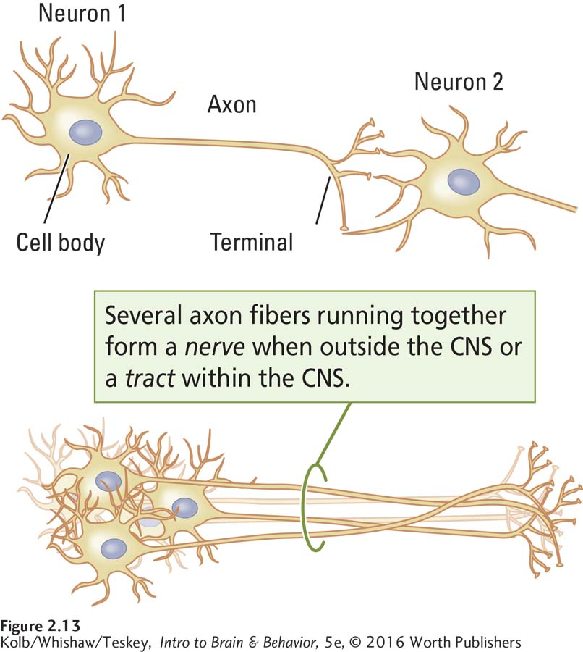

Slide 5
How do neurons work?
Cell Membrane Properties
Ion distribution
Structure
(lipid bilayer)
Na⁺, K⁺, Cl⁻, Ca²⁺
Forces that move ions (gradients)
Permeability
(ion channels)
Membrane potential

Slide 6
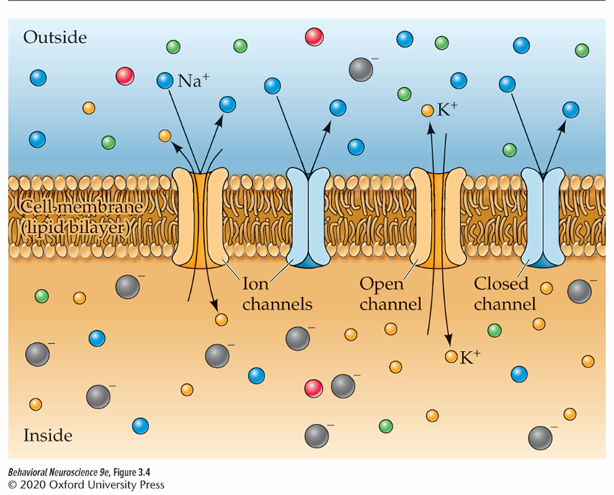
the cell membrane
The cellular membrane is a lipid bilayer
Ion channels are proteins embedded in the cell membrane that allow certain ions to pass through the membrane

Slide 7
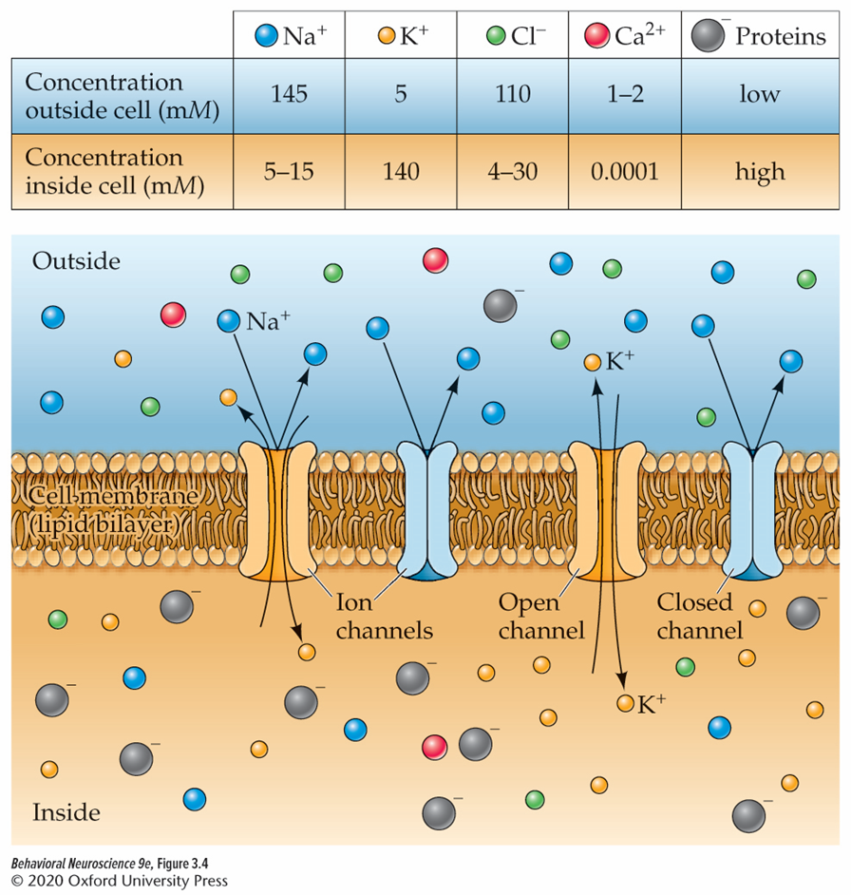
The cell membrane forms two compartments
Outside the Cell:
Extracellular Fluid
(More Positive)
Cell membrane
Inside the cell:
Intracellular Fluid
(More Negative)

Slide 8
The Resting Membrane Potential
Neurons “at rest” have an electrical potential across the membrane
At about –65 mV the neuron is at its resting potential

Slide 9

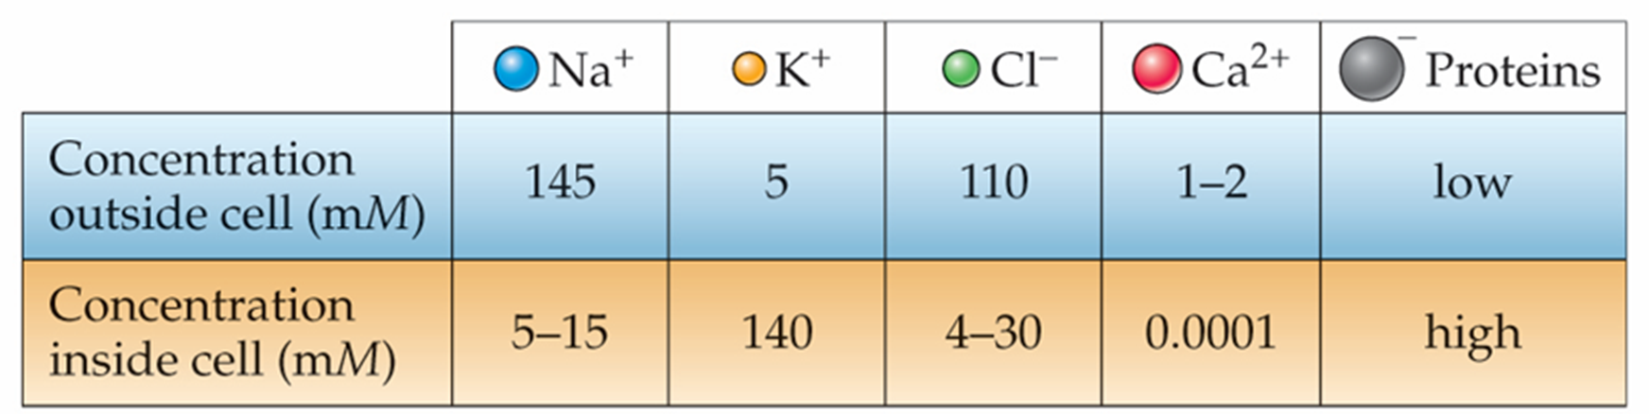
Major Ion players In neural Communication
Positively Charged (+)
Negatively Charged (-)
Sodium
Chloride
Potassium
Calcium

Slide 10
Ion concentrations contribute to the net charge inside and outside the cell at rest
Sodium is mostly outside the cell
Negatively charged proteins are inside the cell
Potassium is mostly inside the cell, but can move outside through leak channels.

Slide 11
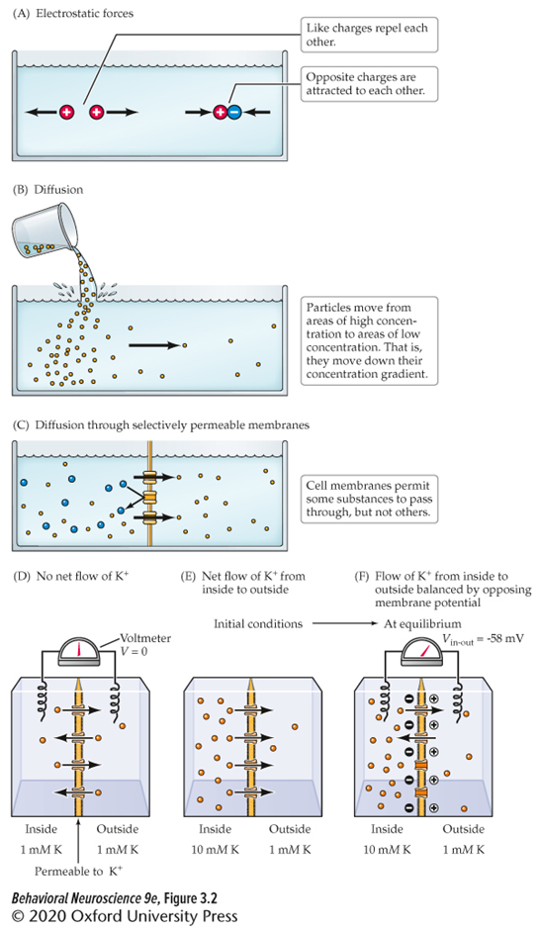
forces that influence ion movement: Electrostatic pressure
Opposite charges attract, while like charges repel

Slide 12
forces That influence ion movement: Diffusion
Like ions flow from areas of higher to lower concentration, along the concentration gradient.

Slide 13
Equilibrium balances electrostatic and diffusion forces.
Equilibrium: the point at which electrostatic pressure and diffusion driving ion movement are equal.

Slide 14
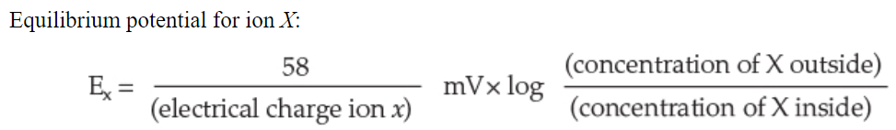
The Nernst equation allows us to calculate the equilibrium potential for a specific ion

Slide 15
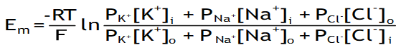
The Goldman equation allows us to calculate Equilibrium potential with multiple ions

Slide 16
Typical Concentrations of Ions at rest

Slide 17
Part 2:
The action potential

Slide 18
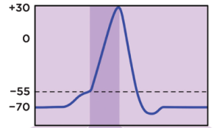
The action potential
The spike in voltage that passes through the axon of a neuron to convey information

Slide 19
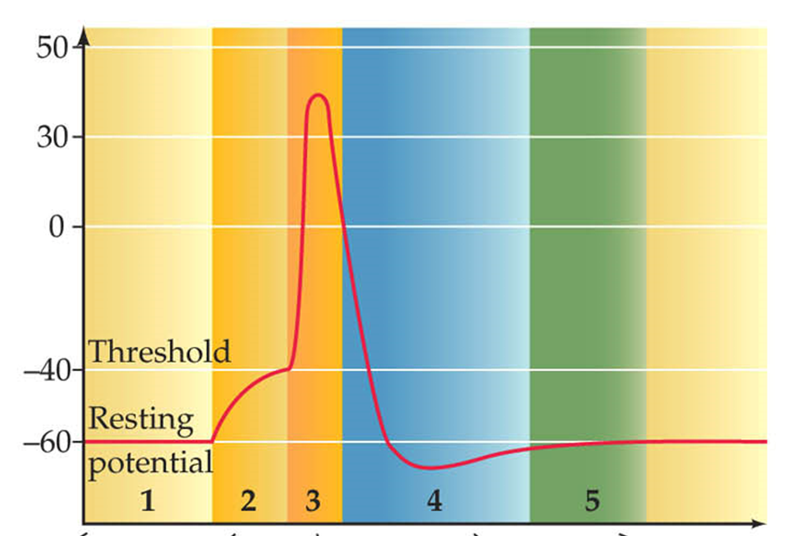
Depolarization to the threshold of activation Triggers an action potential!
Depolarization: when the interior part of a neuron becomes less negative.
Threshold of activation varies, but is around -40 mV
When the threshold of activation is reached, voltage gated sodium channels open and sodium rushes inside the cell.
When an action potential is triggered, it is all or none.
Time

Slide 20
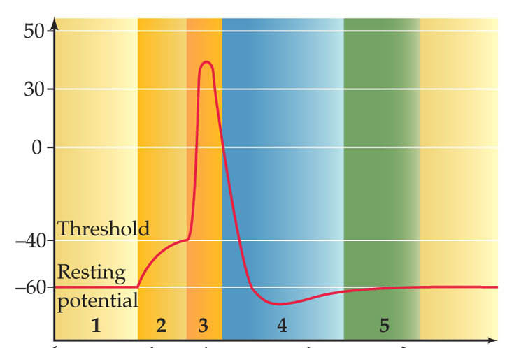

Potassium moving outside the cell brings the membrane potential back down
Hyperpolarization: interior of the neuron becomes more negative.
Voltage gated potassium channels open allowing potassium to move outside the cell.
Refractory periods keep the segment of axon from firing another action potential
Potassium when sodium shows up

Slide 21
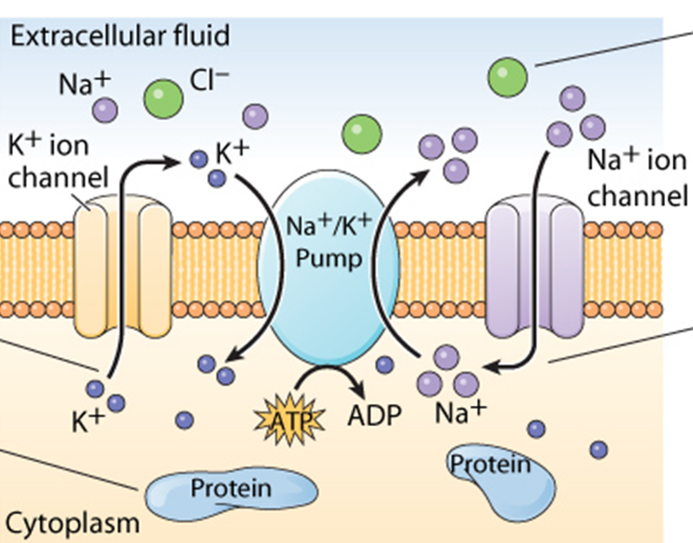

The sodium potassium pump helps reestablish the resting membrane potential
Sodium potassium pump: a membrane bound protein that exchanges 2 extracellular potassium ions for 3 intracellular sodium ions.

Slide 22
